Slide 1




ADEC Technology Innovations
PROJECT REPORT Oct.23,2015
EMA Test Automation Scope

Slide 2




QA TEAM
In-Scope
In-Scope:
Common Functionalities Legend:
a. Log-in - Scripts available
b. Navigation - Scripts not yet available
c. Log-off
Registration
a. Student’s Registration
b. Parent’s Registration
c. Tutor’s Registration
d. Quick Registration
e. Scheduling (On-going)
Maintenance
a. All Appointments
b. Admin Maintenance
c. User Maintenance
d. Reports
My Profile
a. Student’s Profile
b. Tutor’s Profile

Slide 3
QA TEAM
Out of Scope/Lessons Learned
Out of Scope
a)Email Validations/Verification - this can only be done by Manual Testing
Lessons Learned:
a) Selenium Webdriver now can support upload file functionalities

Slide 4



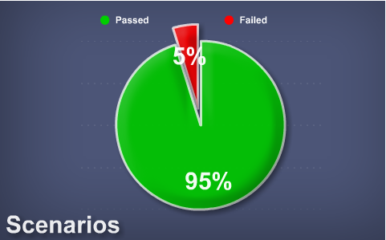
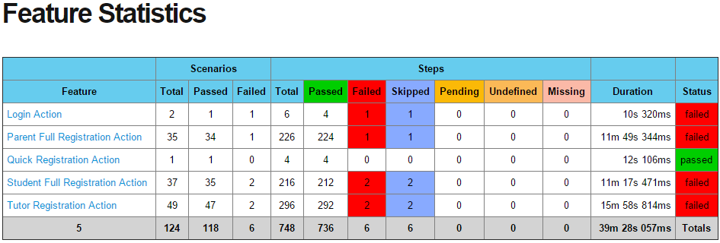
SUMMARY
CM TEAM
SUMMARY
QA AUTOMATION TEAM
HIGHLIGHTS/LOWLIGHTS
HIGHLIGHTS/LOWLIGHTS
Highlights:
Project Status as of 10/19 – 10/23
ProjectWin via Selenium, Cucumber, Gherkins, and Jenkins
Assigned QA: Renaleen Sobere
Five (5) scenarios is due to wrong error message
One (1) scenario is due to element cannot be found even using id/xpath

Slide 5
Thanks for Listening!

